Slide 1
Permitting the Use of County Facilities Hog Day 2018 November 2nd and 3rd Board of Orange County Commissioners Whitted Meeting Facility October 9, 2018
1

Slide 2
Purpose
To consider a request to use River Park, the David Price Farmers Market Pavilion, and other County property for Hog Day 2018 on November 2nd and 3rd which are also the last two days of early voting
2

Slide 3
Early Voting Schedule
Early Voting Schedule for the November 6, 2018 Election
Begins Wednesday, October 17, 2018
Ends Saturday, November 3, 2018
Same Day Voter Registration at all Sites During Early Voting
3

Slide 4
Early Voting Locations
All 5 Early Voting Sites Are Open the Same Days and Hours
BOARD OF ELECTIONS - 208 S. CAMERON ST, HILLSBOROUGH
CARRBORO TOWN HALL, 301 W. MAIN ST, CARRBORO
CHAPEL OF THE CROSS – 304 E. FRANKLIN ST, CHAPEL HILL
SEYMOUR SENIOR CENTER – 2551 HOMESTEAD RD, CHAPEL HILL
EFLAND RURITAN CLUB BUILDING – 3009 FORREST AVE, EFLAND
4

Slide 5
Early Voting Hours
Detailed Hours of Operation
Wednesday – Friday, Oct. 17 – Oct. 19, 7:00 a.m. – 7:00 p.m.
Saturday, Oct. 20, 8:00 a.m. – 3:00 p.m.
Sunday, Oct. 21, 1:00 p.m. – 3:00 p.m.
Monday – Friday, Oct. 22 – Oct. 26, 7:00 a.m. – 7:00 p.m.
Saturday, Oct. 27, 8:00 a.m. – 3:00 p.m.
Sunday, Oct. 28, 1:00 p.m. – 3:00 p.m.
Monday – Friday, Oct. 29 – Nov. 2, 7:00 a.m. – 7:00 p.m.
Saturday, Nov. 3, 8:00 a.m. – 3:00 p.m.
5

Slide 6
Early Voting Hours
Expected Voter Turnout at Board of Elections Site
Most Recent Midterm Election - November 2014
Friday - 874
Closed at 6:00 PM in 2014
Open until 7:00 pm in 2018
Saturday - 872
Closed at 1:00 PM in 2014
Open until 3:00 PM in 2018
Board of Elections Expects Higher Turnout in 2018
Could Exceed 1,000 Voters per Day
Letter from the Board of Elections Signed by All Four Members
Request to Reschedule or Move Hog Day Festival
6

Slide 7
Hog Day Festival
Rescheduled Due to Hurricane Florence
Hours of Operation
Friday, November 2, 2018
6:00 PM to 10:00 PM
Saturday, November 3, 2018
10:00 AM to 6:00 PM
7

Slide 8
Hog Day Festival
County Facility Use – Granted by Permit
River Park
David Price Farmers Market Pavilion
Typical Site Plan
Restricts Traffic Access to Board of Elections Building
Uses Board of Elections Parking Lot for Vendor, Band, and Staff Parking
8

Slide 9
Hog Day Festival
Alternatives to Minimize Early Voting Conflict
Meeting with Event Organizer – October 1
Rescheduling to Saturday/Sunday
Rescheduling to Different Weekend
Develop Access Management Plan – May be Subject to Board Approval
Organizing Committee – Rescheduling Not Feasible
Organizers to Invited to Present Event Disruptions
New Access Management Plan
Maintains Access to Board of Elections Building
Eliminates Use of Board of Elections Parking Lot
Booth to Encourage Voter Participation
9

Slide 10
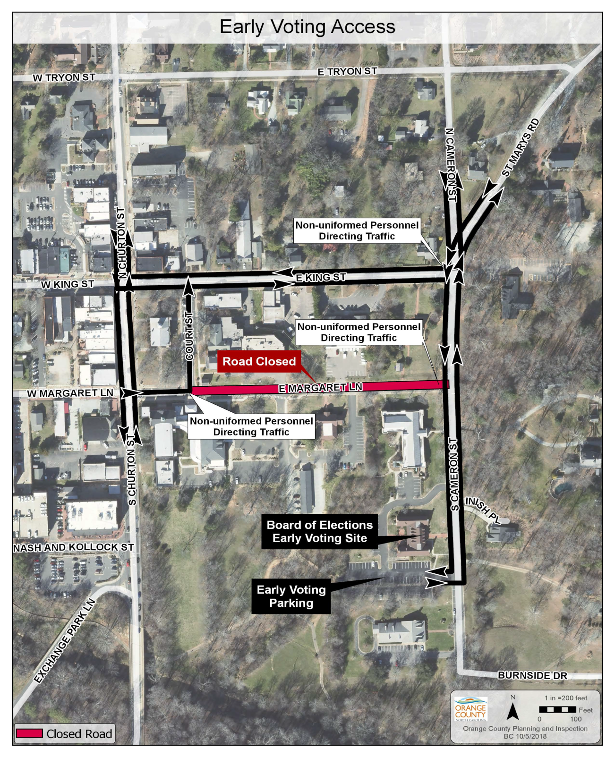
10

Slide 11
Manager’s Recommendation
Consider and Take Action on a Request to Use River Park, the David Price Farmers Market Pavilion, and other County Property for Hog Day on November 2nd and 3rd 2018, which Conflicts with the Last Two Days of Early Voting.
11

