Slide 1
elder star neighborhoods: An Evidence Based Approach (Version 1.0)
Brian J. Morton
Center for Urban and Regional Studies
University of North Carolina at Chapel Hill
October 25, 2014

Slide 2
Overview
“Has not the time come for a much more comprehensive canvass of the social functions of the neighborhood, for a more subtle and sympathetic interpretation of the needs of urban families at every stage in the cycle of human growth, and a more adventurous exploration of alternative solutions?” *
An Elder Star Neighborhood provides the optimal built environment for older American residents
Built environment is the exterior public realm
Main part of presentation comprises photos of neighborhood components necessary for Elder Star Neighborhoods in American small towns and suburbs – “icons,” not necessarily to be taken literally
Evidence based: notes attached to slides refer to scientific and planning studies providing justification for the neighborhood elements
Design principles
Notes:
Source of quotation: Lewis Mumford, “The Neighborhood and the Neighborhood Unit,” The Town Planning Review, 1954, Vol. 24, No. 4, p. 269.

Slide 3
Where should seniors Live?
That depends on the answer to this question…

Slide 4
How should seniors Live?
Seniors should age in community

Slide 5
Aging in community occurs when seniors…
Live safely, comfortably and free of loneliness, boredom, and helplessness
Receive compassionate care from family, friends, and professional staff providing support at the seniors’ homes or in daycare facilities in their neighborhood
Care for other seniors
And…
Notes:
Resource on aging in community: William H. Thomas and Janice M. Blanchard, “Moving Beyond Place: Aging in Community,” in Janice M. Blanchard, Aging in Community, revised edition, Chapel Hill, NC: Second Journey Publications, 2013, pp. 7-17.

Slide 6
Aging in community occurs when seniors…
Reside in intergenerational neighborhoods that:
  facilitate social connections
  provide relief for caregivers
  provide seniors with opportunities to supplement their income
  provide affordable housing to home care aides
Have life stage appropriate access to their own neighborhood, nearby neighborhoods, and the encompassing region

Slide 7
Aging in community can be supported (or defeated) by Built environment – exterior public realm
Buildings
Paths, sidewalks, and roads
Plazas and town squares
Greenways, parks, and public gardens
Contemplative public space
Community food gardens
Farmers’ markets
Mixing of land uses in the same neighborhood
Completeness of individual neighborhoods
Relationships among neighborhoods
Notes:
Resource on the significance of the built environment: William A. Satariano, “Editorial: The Disabilities of Aging—Looking to the Physical Environment,” American Journal of Public Health, March 1997, Vol. 87, No. 3, p. 332.

Slide 8
Selected Facts About America’s Older Adults
Health and Financial Resources

Slide 9
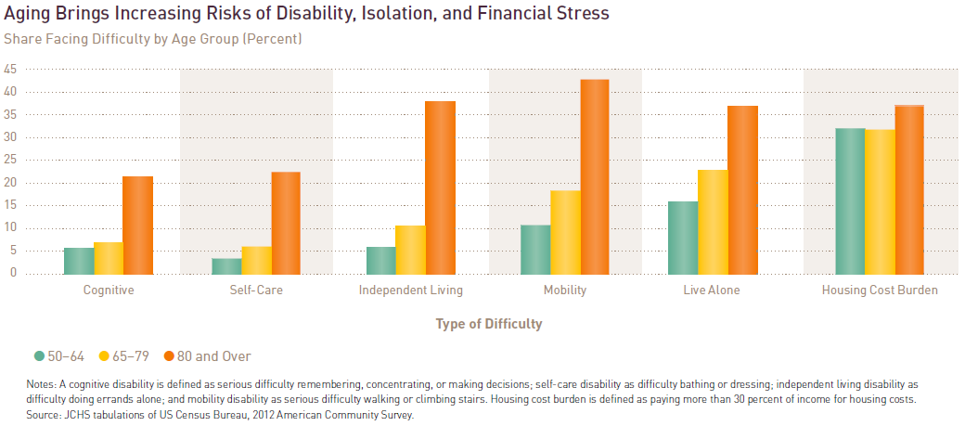
Notes:
Joint Center for Housing Studies of Harvard University, Housing America’s Older Adults: Meeting the Needs of an Aging Population, 2014, p. 3.

Slide 10
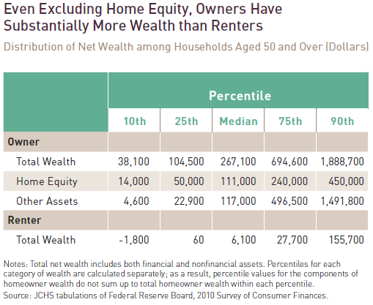
Notes:
Joint Center for Housing Studies of Harvard University, Housing America’s Older Adults: Meeting the Needs of an Aging Population, 2014, p. 16.

Slide 11
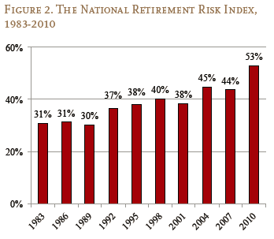
Most Households will not have the resources needed to maintain pre-retirement standard of living
Notes:
“The NRRI shows the share of working households who are ‘at risk’ of being unable to maintain their pre-retirement standard of living in retirement. The Index compares projected replacement rates – retirement income as a percentage of pre-retirement income – for today’s working households with target rates that would allow them to maintain their living standard and calculates the percentage at risk of falling short….Even if households work to age 65 and annuitize all their financial assets, including the receipts from reverse mortgages on their homes, more than half are at risk of being unable to maintain their standard of living in retirement.” (p. 1)
Alicia H. Munnell, Anthony Webb, and Francesca Golub-Sass, The National Retirement Risk Index: An Update, Issue Brief 12-20, October 2012, Center for Retirement Research, Boston College.

Slide 12
Necessary Components of Elder Star Neighborhoods
Small town or suburb

Slide 13
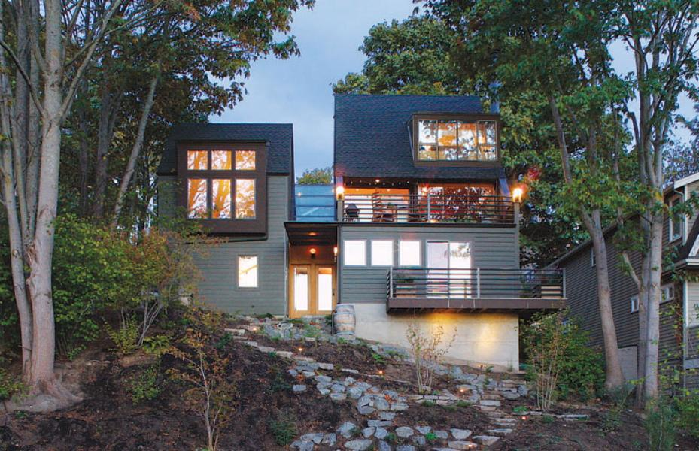
Accessory Dwelling Units left unit
Notes:
Image source: http://www.forbes.com/pictures/efik45fkeke/a-treehouse-rental/
Resources on housing options:
Frank R. Mandy, “The Evolution of Continuing Care Retirement Communities: Not Your Grandmother’s Retirement Community,” in Pauline S. Abbott, Nancy Carman, Jack Carman, and Bob Scarfo, editors, Re-creating Neighborhoods for Successful Aging, Baltimore: Health Professions Press, 2009, pp. 91-114.
Laura Bauer Granberry, “Cohousing and Shared Housing,” in Pauline S. Abbott, Nancy Carman, Jack Carman, and Bob Scarfo, editors, Re-creating Neighborhoods for Successful Aging, Baltimore: Health Professions Press, 2009, pp. 145-163.

Slide 14
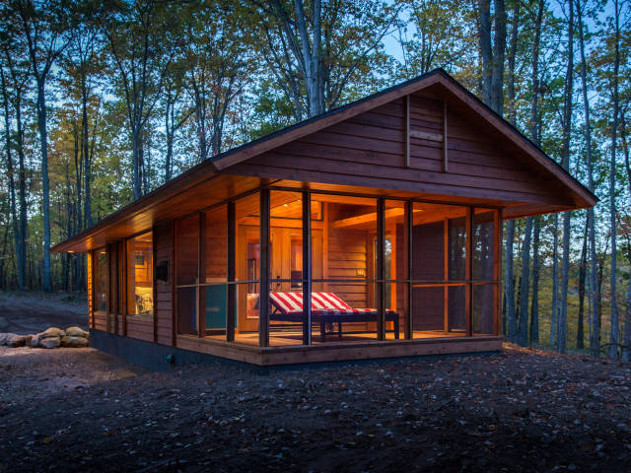
Tiny Houses
392 sq. ft.
Notes:
http://www.countryliving.com/homes/real-estate/tiny-house#slide-5

Slide 15
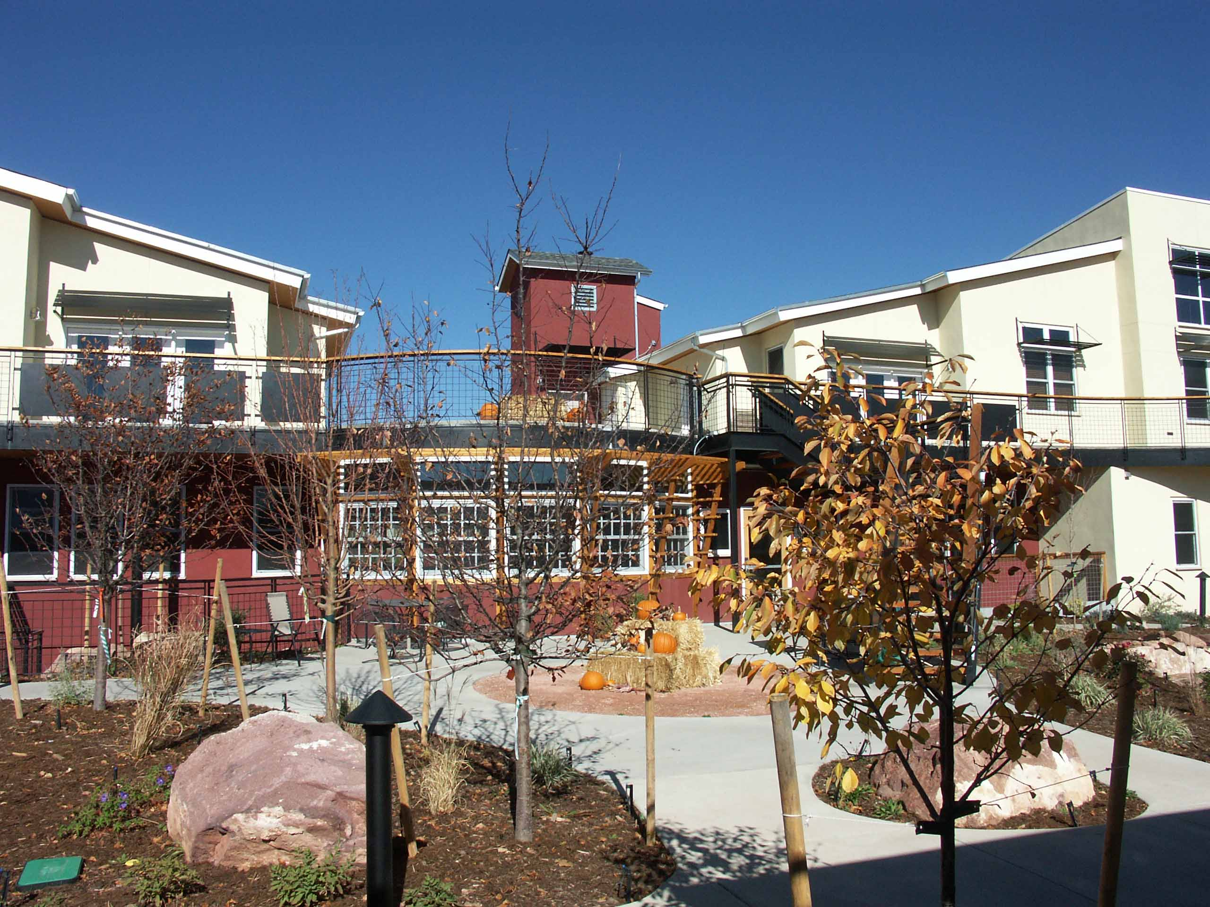
Senior Cohousing
Silver Sage Village, Boulder, CO
Notes:
http://silvertipconsultants.com/Projects/Silver_Sage/PICT0891-a.jpg

Slide 16
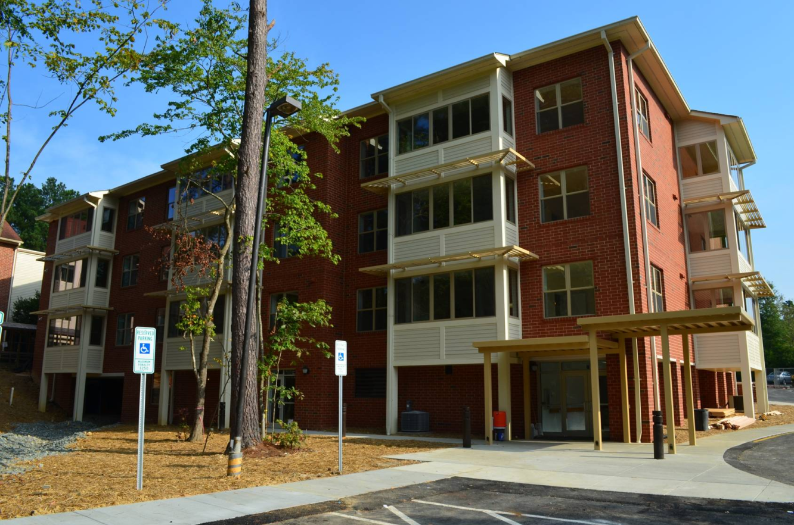
Continuing Care Retirement Community
Carol Woods Retirement Community, Chapel Hill
Notes:
http://www.carolwoods.org/wp-content/gallery/phototour/building-1_new.jpg

Slide 17
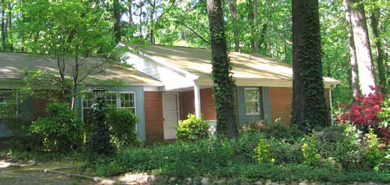
Small Eldercare Home
Charles House – Yorktown, Chapel Hill
Notes:
http://www.charleshouse.org/Newsletters/spring2010.pdf

Slide 18
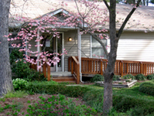
Small
Daytime
Adult
Daycare Facility
Charles House – Hillcrest, Carrboro
Notes:
http://www.charleshouse.org/images/CH.front.jpg

Slide 19
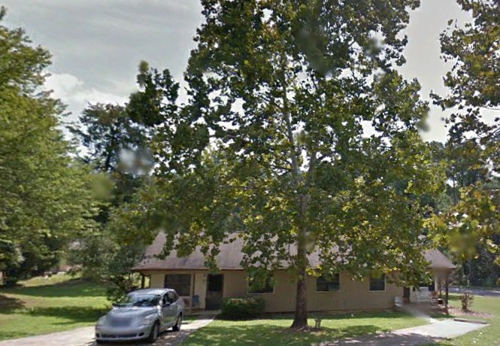
Affordable Housing for Home Care Aides and Other Workers
Eastwood, Chapel Hill
Notes:
Resource on home care aides: Home Care Aides at a Glance, Facts 5, Paraprofessional Healthcare Institute, Bronx, NY, 2014, .

Slide 20
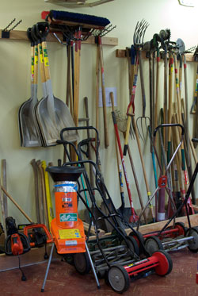
Tool Library
Northeast Portland Tool Library, Oregon
Notes:
Image source: http://www.neptl.org/wp-content/uploads/2010/07/tools.jpg
Resource on the sharing economy: Gaya Erlandson and Janelle Orsi, “The Sharing Solution,” in Janice M. Blanchard, Aging in Community, revised edition, Chapel Hill, NC: Second Journey Publications, 2013, pp. 139-152.

Slide 21
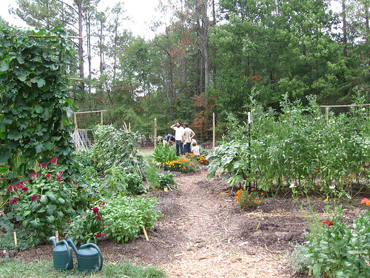
Community Garden
Carrboro Community Garden
Notes:
Image source: http://farm2.static.flickr.com/1397/1306524688_caebb3e99e.jpg?v=0
Resources on gardening, including food gardens:
Donna Wang and Thalia Macmillan, “The Benefits of Gardening for Older Adults: A Systematic Review of the Literature,” Activities, Adaptation and Aging , 2013, Vol. 37, No. 2, pp. 153-181.
“This article systematically reviews evidence for gardening as a beneficial activity for older adults. The authors reviewed 22 articles that assessed the benefits of gardening for both community-dwelling and institutionalized older adults. Through various research designs (quantitative and qualitative) and measurements utilized, the results reveal that gardening can be an activity that promotes overall health and quality of life, physical strength, fitness and flexibility, cognitive ability, and socialization. The implementation of various aspects of gardening as health-promoting activities transcend contexts of practice and disciplines and can be used in urban and rural communities as both individual and group activities.” (p. 153)
Ulrich Schmutz, Margi Lennartsson, Sarah Williams, Maria Devereaux and Gareth Davies, The Benefits of Gardening and Food Growing for Health and Wellbeing, Garden Organic and Sustain, Coventry, UK 2014.
“This review of the scientific literature set out to demonstrate the strength of evidence for the
benefits of gardening and food growing for physical and mental health and wellbeing. It shows
that:
..to improve physical health, regular involvement in gardening or community food
growing projects, or formal horticultural therapy, can:
• Increase overall levels of physical activity and fitness, burn more calories and hence
contribute to healthy weight management and reducing the risk of obesity.
• Increase healthy fruit and vegetable consumption, for adults that grow food, and among
schoolchildren participating in food-growing activities at school – as well as improving young
people’s attitudes to healthy eating.
• Reduce physical pain, and help with rehabilitation or recovery from surgery or other medical
interventions.
• Help people cope with physically challenging circumstances, such as intensive cancer
treatment or learning how to live with chronic conditions such as asthma or severe allergies.
..to improve mental health, for people with acute or persistent mental health problems, or
especially difficult personal circumstances, regular involvement in gardening or
community food-growing projects, or formal horticultural therapy, can:
• Contribute to improved social interactions and community cohesion.
• Reduce the occurrence of episodes of stress, and the severity of stress and associated
depression.
• Reduce reliance on medication, self-harming behavior, and visits to psychiatric services,
whilst also improving alertness, cognitive abilities and social skills.
• Alleviate symptoms of dementia and Alzheimer’s disease, such as agitation and aggressive
behavior, which can in turn improve circumstances for carers.
• Provide productive manual activity and beneficial social interaction for people tackling drug
and alcohol dependency.
• Help people manage the distress associated with mentally challenging circumstances, such
as making the end of life more peaceful, sociable and enjoyable for hospice patients.” (p. 4)

Slide 22
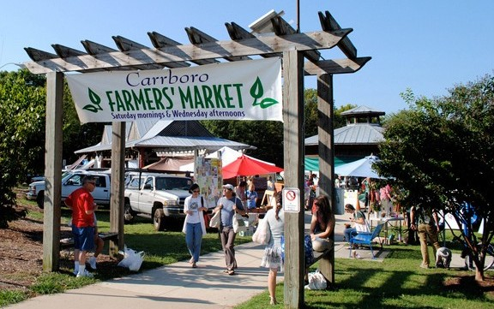
Farmers
Market
Carrboro Farmers
Market
Notes:
Image source: http://www.southernfoodways.org/assets/Carrboro-Farmers-Market-e1372193326433.jpg
Resource on farmers markets:
Anne L. Alonzo, Agricultural Marketing Services Administrator, USDA, USDA Blog, Farmers Markets as Community Centerpieces, August 5, 2013
“Beyond the economic and business benefits, farmers markets give communities across the country access to fresh, healthy foods, especially in urban and rural areas where shopping options may be limited. What began as a business necessity for many small farmers has evolved into a social event for entire communities, with many families and patrons viewing a trip to the Saturday morning market as the start of their social weekend. As markets grow, new features like live music, cooking demonstrations, gardening tips and educational opportunities are added. Businesses that surround farmers markets also benefit from the additional foot traffic that the market brings.”
http://blogs.usda.gov/2013/08/05/farmers-markets-as-community-centerpieces/#sthash.3I8PNmd5.dpuf

Slide 23
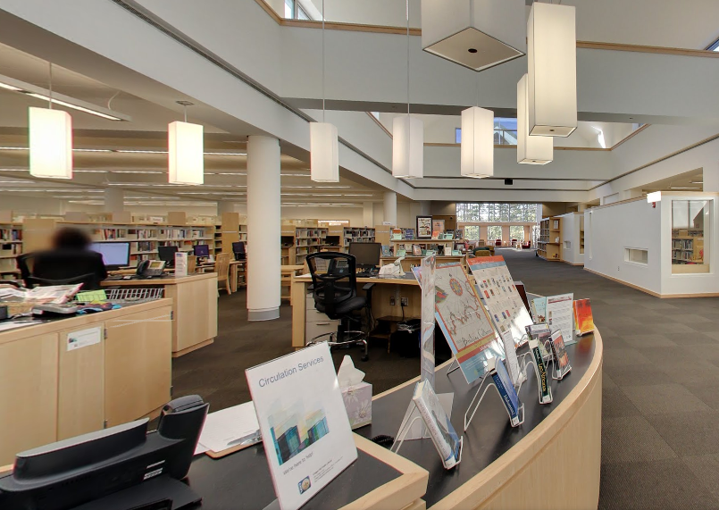
Public Library
Town of Chapel Hill – Public Library
Notes:
Image source: https://www.google.com/maps/place/Town+of+Chapel+Hill+-+Public+Library/@35.932126,-79.0357793,15z/data=!4m2!3m1!1s0x0:0xd7fb009cb6fc9924
Resource on public libraries:
Glen E. Holt, Donald s. Elliott, Leslie E. Holt, and Anne Watts, Public Library Benefits Valuation Study, April 2001, http://www.slpl.lib.mo.us/libsrc/valuation.htm.
“Annual local taxes spent for library operations yield substantial direct benefits. Each library returns more than $1 of benefits for each $1 of annual taxes. Baltimore County Public Library returns $3-$6 in benefits per tax dollar. Birmingham Public Library returns $1.30-$2.70 in benefits per tax dollar. King County Library System returns $5-$10 in benefits per tax dollar. Phoenix Public Library returns over $10 in benefits per tax dollar. SLPL returns $2.50-$5 in benefits per tax dollar.”
http://www.slpl.lib.mo.us/libsrc/valuationg.htm

Slide 24
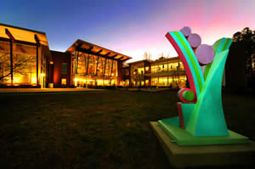
Local Government Senior Center
Robert & Pearl Seymour Center, Chapel Hill
Notes:
Image source: http://www.co.orange.nc.us/aging/images/SeymourCenteratTwilight.JPG
Resource on senior centers:
Ronald H. Aday, The Evolving Role Of Senior Centers In The 21st Century, testimony before Senate Special Committee on Aging, May 20, 2003.
http://www.indiana.edu/~leisure/module2/unit3_LA2/readings/Aday-Role%20of%20Sr%20Ctrs.pdf
“Based on a recent survey (Aday, 2003) of approximately 20 senior centers in seven states it was found that older adults who currently frequent senior centers are typically in their midseventies with about one-third over the age of 80. Most users are single Caucasian females who are relatively well educated compared to seniors a decade or so ago. Although varying from center to center, about one-half of senior participants live alone. Seventy-five percent of center users come to the center 1-3 times a week and usually spend an average of 3.3 hours per day. Many senior center participants come for specific educational or health promotional programming rather than spending the entire day at the center. While about one-third have been attending senior centers for three years or less, 50% report participating for seven or more years. Only 20% have failed to complete high school and the same number (20%) are college graduates. The majority report receiving helpful information, increased knowledge, and learning new skills, which contribute to their continued independence.” (p. 3)
“For older persons at risk of losing their self-sufficiency, senior centers are an entry point to an array of services that will assist them as they “age in place.” Senior centers offer a wide range of health, education, recreation, volunteer and other social interaction opportunities for their participants that enhance dignity, support independence, and encourage community involvement. Centers are also a resource for the entire community, providing services and information on aging, and assisting family and friends who care for older persons. Senior centers can optimally provide a social environment conducive to the development of a social support system reducing loneliness and depression.” (p. 4)

Slide 25
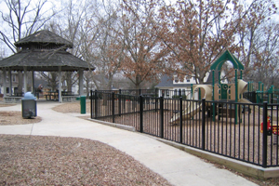
Pocket park
Trinity Park, Durham, NC
Notes:
Image source: http://www.ci.durham.nc.us/gis_apps/parkapp/JPGFiles/Trinity_Park.jpg
Resource on pocket parks:
Karin K. Peschardta, Jasper Schipperijnb, and Ulrika K. Stigsdottera, “Use of Small Public Urban Green Spaces (SPUGS),” Urban Forestry & Urban Greening, 2012, Vol. 11, Issue 3, pp. 235-244.
“During recent years, the use of urban green space (UGS) has received increased attention within several research fields, as well as politically, especially in relation to the benefits it provides for human health. Much research on larger green areas has shown that they are beneficial to people’s health, physically, socially and mentally. However, because of densification tendencies in cities in Western countries, large green areas are a limited resource and many people live in city areas where the distance to larger green areas reduces the possibility for frequent use. Small Public Urban Green Spaces (SPUGS) in dense city areas might contribute to satisfy the need for everyday experiences of outdoor areas, but research on SPUGS is limited. In this paper, we describe how nine SPUGS in Copenhagen are used by the citizens based on data from 686 respondents who completed on-site questionnaires during their visit. The results show that SPUGS are primarily used for ‘socializing’ and ‘rest and restitution’. Furthermore, they are mainly used by well-educated people between the ages of 30 and 49. For ‘socializing’, SPUGS are primarily used on the way home. For ‘rest and restitution’, SPUGS are primarily used ‘en route’ or on the way home. More than half of the respondents reported living more than 1000 m from the SPUGS, and more than half of the respondents reported that they travel more than 500 m to get to the SPUGS. People aged 50–65 are more likely to visit the SPUGS for ‘rest and restitution’ than the younger age groups. Furthermore the older people are, the less likely they are to visit SPUGS to socialize. These results show that SPUGS are an important asset in citizen’s everyday lives, and the results may provide inspiration for landscape architects, city planners and policy makers for the future planning of dense city areas.” (p. 244).

Slide 26
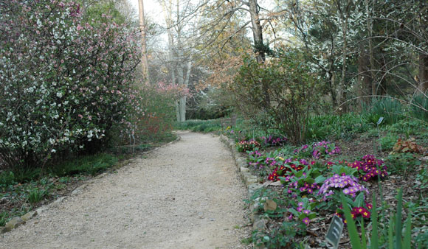
Contemplative and restorative Public Spaces
Coker Arboretum, UNC-Chapel Hill
Notes:
Image source: http://ncbg.unc.edu/uploads/images/ArbSpringPath.jpg
Resource on contemplative and restorative public spaces:
Kathleen Wolf, Katrina Flora, and Elizabeth Housely, Research on the Beneficial Aspects of the Experience of Nature in Cities: A Literature Review, February 2012, Annapolis, MD: TKF Foundation.

Slide 27
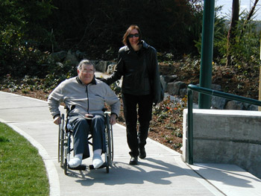
Well-maintained Sidewalks Appropriate for Wheelchairs
Notes:
Image source: http://www.pedbikeimages.org/pubdetail.cfm?picid=1213
Resources on older adults’ travel behavior:
Daniel J. Foley, Harley K. Heimovitz, Jack M. Guralnik, and Dwight B. Brock, “Driving Life Expectancy of Persons Aged 70 Years and Older in the United States,” American Journal of Public Health, August 2002, Vol. 92, No. 8, pp. 1284-1289.
“Use of these rates in a life table application showed that male drivers who were aged 70 to 74 years at baseline would have a total life expectancy of approximately 18 years and a driving life expectancy of about 11 years (Table 3 , last column). In contrast, although the total life expectancy for women aged 70 to 74 years would be approximately 21 years, their driving life expectancy would be similar to men’s, only 11 years. These findings suggest that, on average, male drivers aged 70 to 74 years will be dependent on alternative sources of transportation for approximately 7 years and that female drivers of the same age will be dependent on alternative sources of transportation for approximately 10 years. Among the oldest old drivers in this cohort (those aged 85 years and older), driving life expectancy was approximately 2 years, and this remaining period of driving covered about one-third of the total life expectancy for men and about one-fourth of the total life expectancy for women. Stratification of the drivers by standard metropolitan statistical area residence resulted in similar estimates of driving life expectancy.” (p. 1286)
Linda Baily, Aging Americans: Stranded Without Options, Washington: Surface Transportation Policy Project, 2004.
“More than one in five (21%) Americans age 65 and older do not drive. Some reasons include:
• Declining health, eyesight, physical or mental abilities;
• Concern over safety (self-regulation);
• No car or no access to a car;
• Personal preference.” (p. iii)

Slide 28
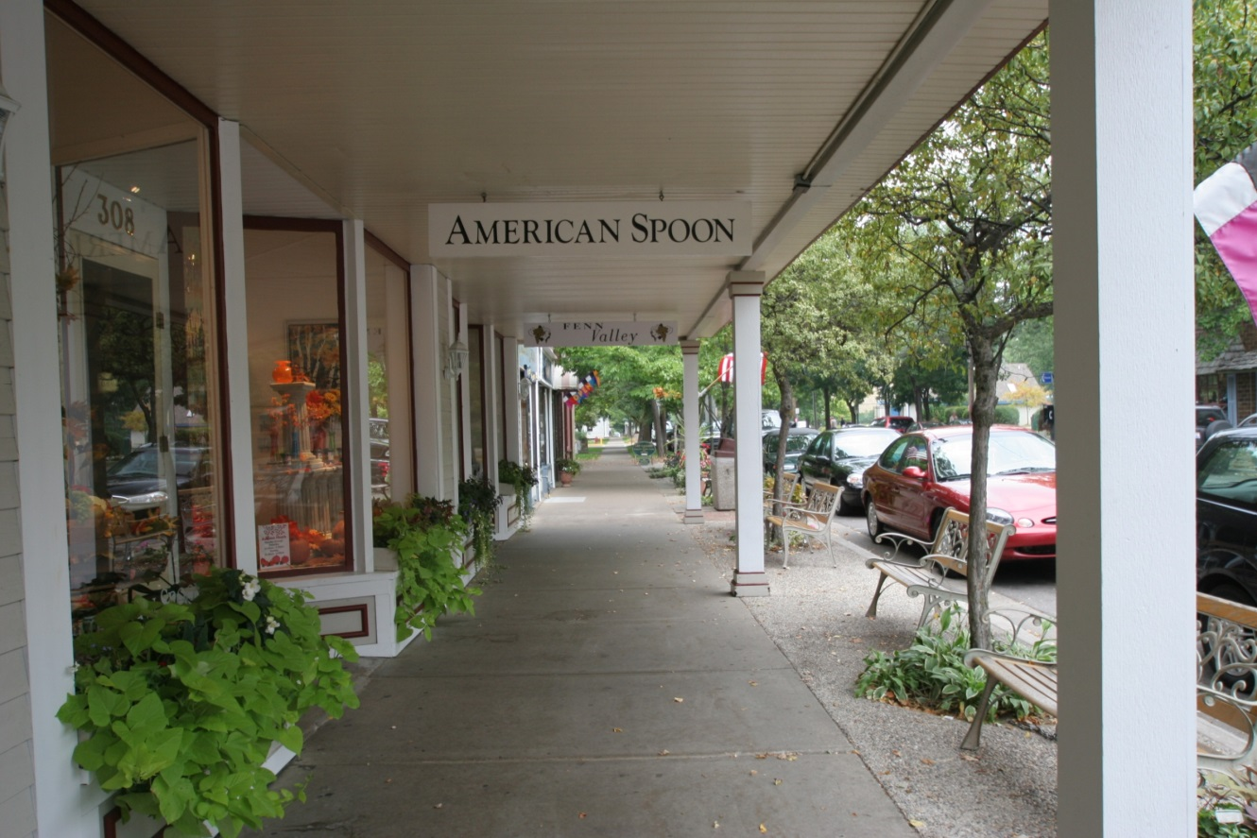
Sidewalk Bench
Saugatuck, MI
Notes:
Image source: http://www.pedbikeimages.org/largeimages/mi.saugatuck.coveredsidewalk-large.jpg

Slide 29
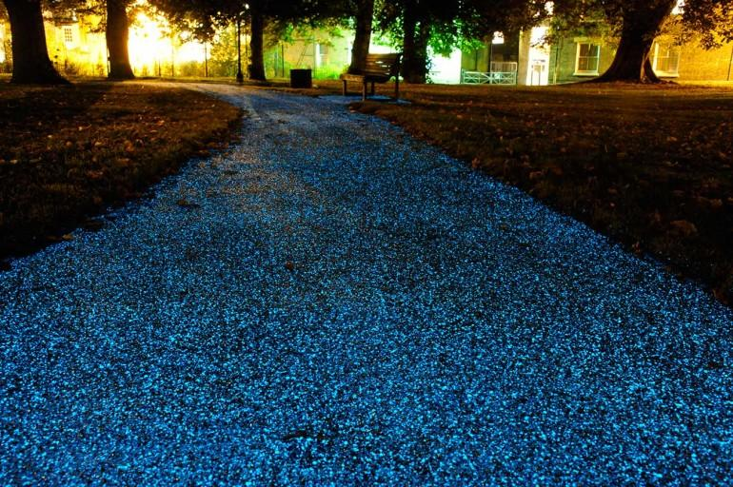
Illuminated Sidewalk
StarPath (Pro-Teq Surfacing (UK) Ltd.
Notes:
Image source: http://s3.amazonaws.com/digitaltrends-uploads-prod/2013/10/starpath-glowing-pathway.jpg

Slide 30
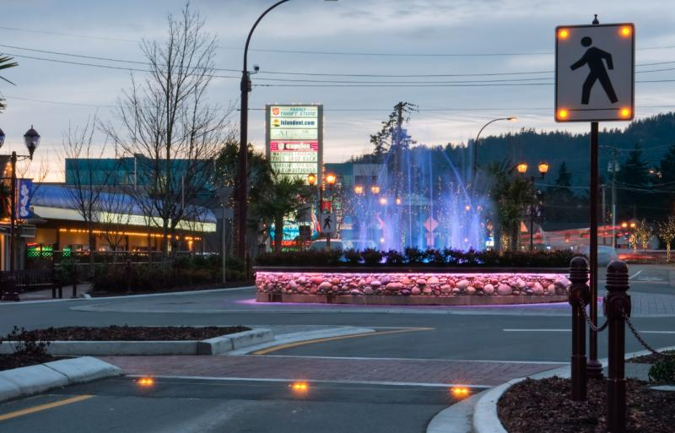
Flashing Crosswalk Lights
Langford, BC
Notes:
Image source: http://www.itemltd.com/media/filter/large/img/roundabout.jpg

Slide 31
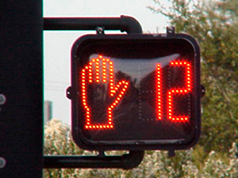
Pedestrian Countdown Signal timed to Seniors’ Walking Speed
0.8 m/s – not 1.2 m/s
Notes:
Image source: http://mtc.ca.gov/planning/bicyclespedestrians/tools/countdownSignal/image1.jpg
Resource on older adult’s walking speeds:
Laura Asher, Maria Aresu, Emanuela Falaschetti, and Jennifer Mindell, “Most Older Pedestrians Are Unable to Cross the Road in Time: A Cross-Sectional Study, Age and Ageing, 2012, Vol. 41, Issue 5, pp. 690-694.
“The assumed ‘normal’ walking speed of 1.2 m/s is utilized internationally as the basis for pedestrian crossing timings. Our results show that pedestrian crossings requiring a walking speed of 0.8 m/s may be more appropriate, as this would allow the ‘average’ man or woman ≥65 years sufficient time to cross. The current assumed walking speed excludes most of the older population in England from using pedestrian crossings and therefore should be revised.” (p. 693)

Slide 32
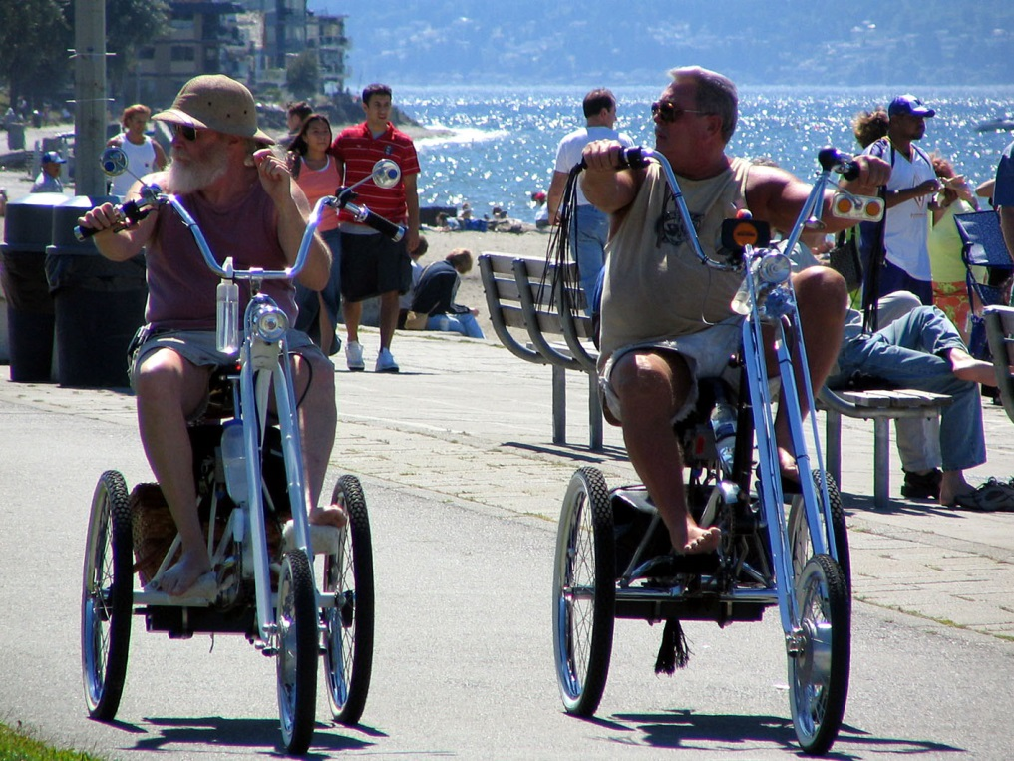
Bike lanes and paths Wide Enough for Adult tricycles
Seattle
Notes:
Image source: http://www.pedbikeimages.org/largeimages/alkai.seattle(146).jpg

Slide 33
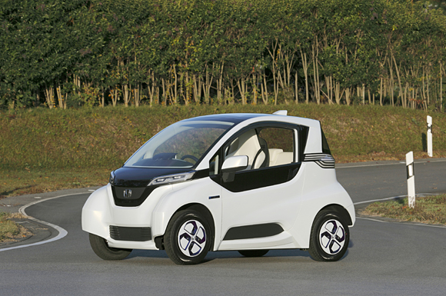
Slow Lanes for Neighborhood Electric Vehicles
Honda Micro Commuter Prototype
Notes:
Image source: http://world.honda.com/news/2012/4121113Micro-EV-Commuter-Prototype/photo/pages/02.html
Resource on neighborhood electric vehicles:
Daniel Sperling, “Prospects for Neighborhood Electric Vehicles,” Transportation Research Record, 1994, Vol. 1444, pp. 16-22.
“NEVs also address a variety of social ills associated with increased
automobility: lack of mobility by poor, elderly, and physically
disabled persons; consumption of large quantities of land;
and marginalization of the most environmentally benign forms of
travel: walking and bicycling.
“Increased mobility for those precluded from driving because of
physical disabilities is especially compelling in places where transit
service is sparse, as is the case in most of the United States.
The ease of driving a NEV makes it accessible to a broader range
of individuals, including the expanding elderly population (the
population of individuals over the age of 50 in the United States
is expected to almost double between 1990 and 2020, from 63.5
million to 112 million). One option for making already easy-to-drive
NEVs more accessible to mobility-impaired individuals is
to substitute the driver’s seat with a place for a wheelchair. Other
options are to adapt the already simple driving controls to hand
controls and to partially or fully automate the controls.
“The use of NEVs, because of their smaller size, would provide
another benefit: an opportunity to shrink lane widths and parking
space and expand the capacity of existing road space.
The greatest contribution of NEVs, however, may ultimately be
as a stand-in for nonmotorized travel. Over time automobiles have
come to dominate the thinking and actions of local governments.
Governments have focused attention on creating a safe and accommodating
environment for cars--building abundant roads and
parking spaces and imposing traffic controls to ensure speedy, safe
travel. Many neighborhoods do not even have sidewalks. Mathematical
travel demand models, used to prioritize new transportation
investments, usually ignore bicycles and pedestrians.
Pedestrians and bicyclists are usually afterthoughts. The most
long-lasting effect of NEVs paradoxically might be to reverse the
trend toward less nonmotorized travel.
“The appearance of NEVs, even in small numbers, forces a rethinking
of rules and investments preoccupied with the automobile.
More important the use of NEVs, even in limited circumstances,
provokes planners, politicians, zoning boards, and others
who write building and street codes to rethink their car-centric
rules and plans. NEVs would provide a justification for rewriting
building and traffic rules and diverting road and land development
investments toward the needs of pedestrians and bicyclists. Gradually
bikeways and pedestrian paths might become more widespread
and more intensively used. Walking and bicycles are not
for everyone, but even a small shift from motorized vehicles
would have positive effects on congestion, pollution, and energy
use.” (p. 18)

Slide 34
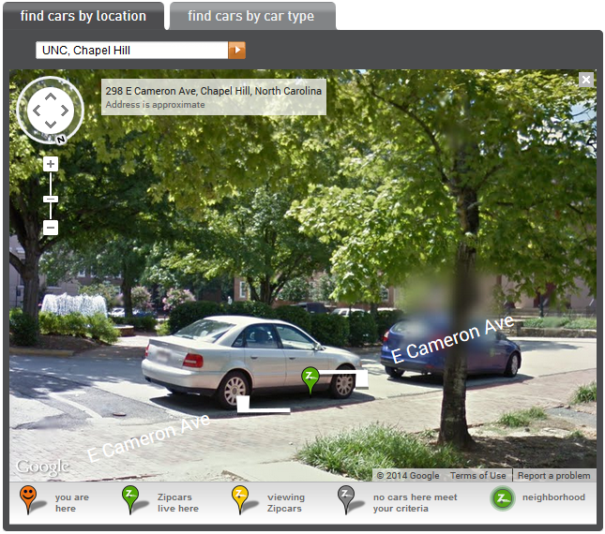
Parking spaces for autos for short term hire
Zipcar on UNC-Chapel Hill campus
Notes:
Image source: http://www.zipcar.com/unc

Slide 35
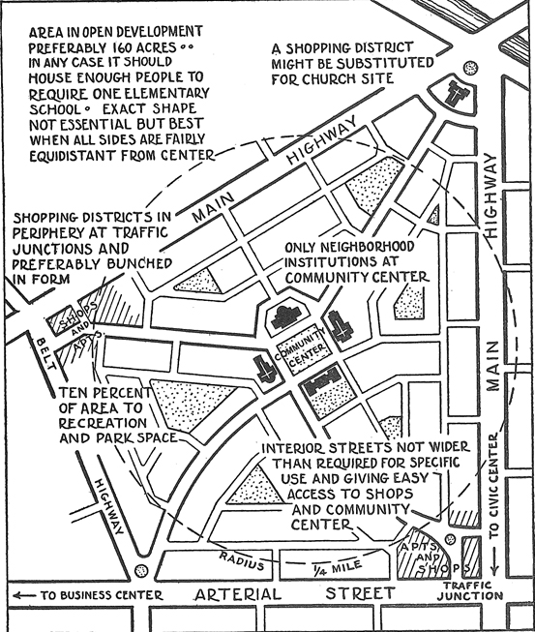
(Nearly) Complete Neighborhoods
1927 vintage “neighborhood unit”
Notes:
Image source: Jerrold R. Allaire, Neighborhood Boundaries, Information Report No. 141, Chicago: American Planning Association, 1960 (https://www.planning.org/pas/at60/report141.htm)
Resource on the neighborhood unit – classic and eloquent, if dated:
Lewis Mumford, “The Neighborhood and the Neighborhood Unit,” The Town Planning Review, 1954, Vol. 24, No. 4, pp. 256-270.
“Perry's concept of the neighborhood unit carried a step further the earlier notion, first introduced in Germany, of dividing a city into specialized zones. Treating the domestic quarters of the city as a functional zone, to be differentiated in plan, because of its different needs, from the industrial or commercial zones, he established likewise the need for a nuclear treatment of the domestic zone, since the acceptable dimensions of a neighborhood depended upon such relation-ships as a quarter-mile walk to a local playground or a half-mile walk to the local school, to say nothing of such indeterminate though limited distances as those a housewife will willingly walk to do her marketing or shopping. All this seems like such elementary common sense that one wonders that anyone should seriously challenge it. Where such spatial relations are flouted - as they so often are in the spotty, inconsecutive, irrational ‘planning' of our time - the members of the community pay for it in extra time and expense and inconvenience, in putting further burdens on the transportation system, in paying extra assessments for otherwise extravagant streets and traffic avenues, or in simply doing without facilities that properly belong within a residential quarter. The neighborhood is based, essentially, on the needs of families; particularly on the needs of mothers and children from the latters' infancy up to adolescence; as well as upon the needs of all age groups for having access to certain common cultural facilities; the school, the library, the meeting hall, the cinema, the church. To have all these institutions within easy reach of the home is a guarantee of their being steadily used by all the members of the family, while to have them scattered and unrelated, especially in distant parts of the city, is to dis-courage their constant use and often, when children must be cared for, to prevent their use entirely - except at the price of family neglect.” (pp 263-264)

Slide 36
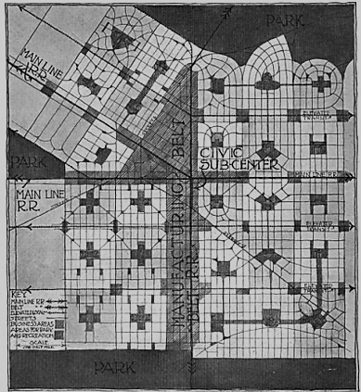
Well connected, nearly Complete, and complementary neighborhoods
An historical (1913) Example of neighborhoods seamlessly connected to each Other and the Region
Notes:
Image source: Alfred B. Yeomans (ed.), City Residential Land Development: Studies in Planning: Competitive Plans for Subdividing a Typical Quarter Section of Land in the Outskirts of Chicago, Chicago: University of Chicago Press, 1916, p. 38.

Slide 37
Conclusion:
Design for activity, conviviality, and the spirit
Broad housing choice, including small – even tiny – houses
Physical activity every day
All ages
Diverse incomes
Slow, active mobility
Nearly car free
Sharing
Social interaction
Contemplation
Nearly complete individual neighborhoods
System of complementary neighborhoods

